Slide 1

Implant materials for bone and joints
Louisiana Tech University
College of Engineering and Science
BIEN 235
Dr. Teresa Murray

Slide 2
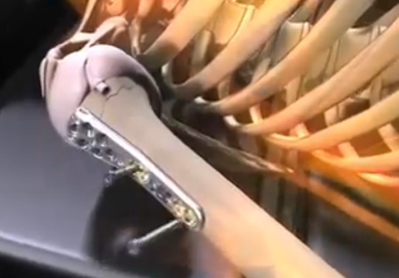
Fixation and replacement joint devices
Louisiana Tech University
College of Engineering and Science
DePuy products advertisement
… putting Michaelangelo back together again …
http://www.youtube.com/watch?NR=1&v=IPRddQcfD9s

Slide 3
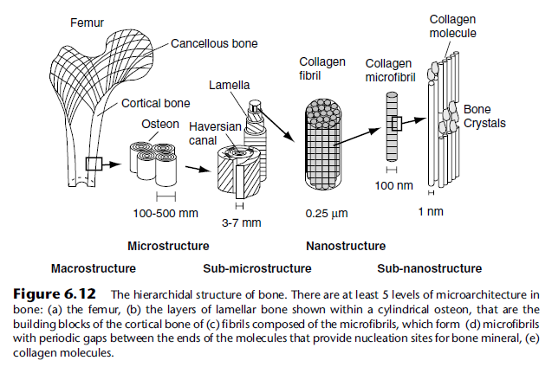
Bone
Louisiana Tech University
College of Engineering and Science
Anisotropic Composite Biological Material
Compression: Strong
Tension: weaker
Torsion and bending:
Weak
This textbook figure has 100-500 mm and 3-7 mm. This should be microns (μm)

Slide 4
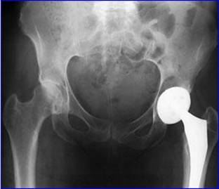
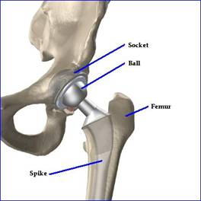
Hip anatomy and arthroplasty
Louisiana Tech University
College of Engineering and Science
Illium
Acetabulum
Femoral head
http://www.millerandzois.com/stryker-hip-settlement.html

Slide 5
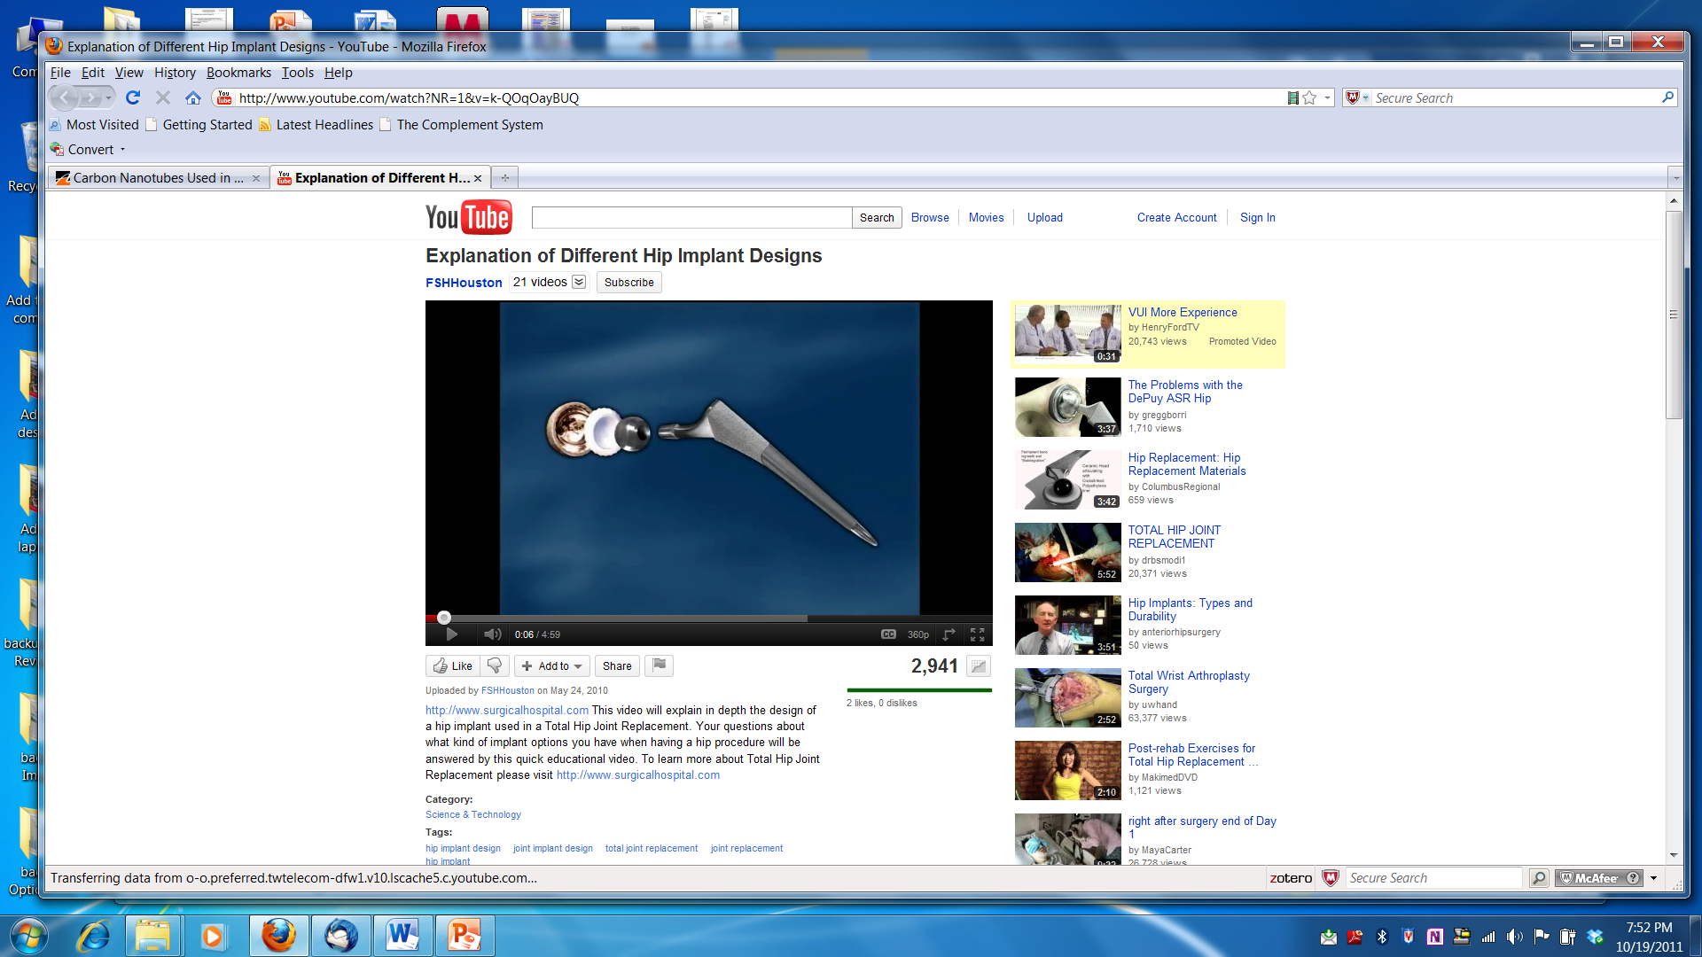
Components of traditional hip implant
Louisiana Tech University
College of Engineering and Science
Hip implant types Animation Zirconium Advertisement
http://www.youtube.com/watch?NR=1&v=k-QOqOayBUQ

Slide 6
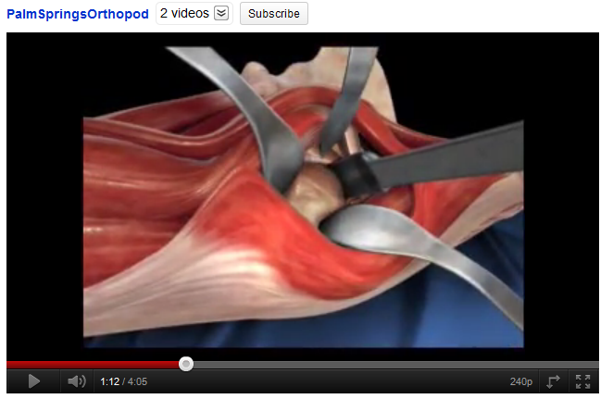
Hip replacement surgery
Louisiana Tech University
College of Engineering and Science
Animation of total hip arthroplasty
http://www.youtube.com/watch?v=Bwi0i1EtbpI&feature=related

Slide 7
Hip replacement components
Louisiana Tech University
College of Engineering and Science
What are the desired material properties?
Stem (1-2 parts plus femoral head)
Femoral head (may be 1 piece with stem)
Acetabular cup (may have >1 part)
What are the biological concerns?

Slide 8
Components of traditional hip implant
Louisiana Tech University
College of Engineering and Science
Hip implant types Animation Zirconium Advertisement
http://www.youtube.com/watch?NR=1&v=k-QOqOayBUQ

Slide 9
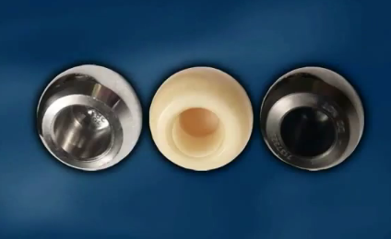
Some of the materials
Louisiana Tech University
College of Engineering and Science
Co Cr alloys and Ti alloys
Ceramics
Polymers (UHMWPE)
Bone cement
What are the mechanical properties?
How biocompatible are they?
http://www.youtube.com/watch?NR=1&v=k-QOqOayBUQ

Slide 10
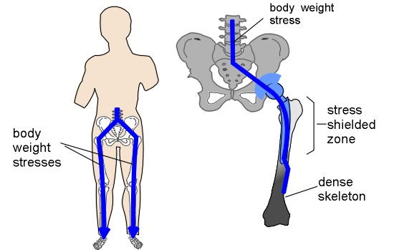
Stress shielding
Louisiana Tech University
College of Engineering and Science
NOTE: Each leg has half the stress from the whole body
http://www.bananarepublican.info/Stress_shielding.htm

Slide 11

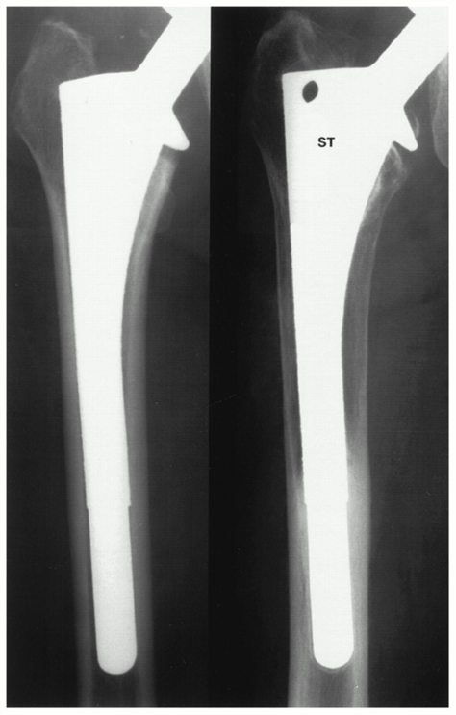
From: Long-Term Clinical Consequences of Stress-Shielding after Total Hip Arthroplasty without Cement*
The Journal of Bone and Joint Surgery (American) 1997; 79:1007-12
“Stress-shielding” eventually weakens bone on one side of implant
What happens then?
Radiographs showing pronounced bone remodeling with evidence of bone ingrowth (square). Immediate postoperative radiograph (left) shows an anatomic medullary locking stem that fills the intramedullary canal at the isthmus. Radiograph (right) after 2 years is typical of patients in the study. Note pronounced bone-remodeling, marked thinning and decreased density of the cortices, and smooth surface of substrate that is indicative of osseointegration.
Date of download: 10/18/2011
Copyright © The Journal of Bone & Joint Surgery. All rights reserved.

Slide 12
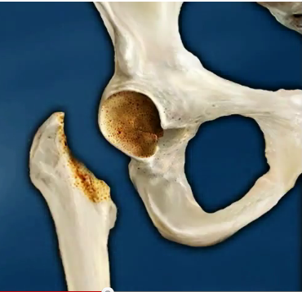
Osteolysis
Louisiana Tech University
College of Engineering and Science
Metal-on-polyethylene implants
microscopic polyethylene wear fragments shed from implant
immune system attacks these
can ‘eat away’ surrounding bone
weakens bone, implants loosen
Many orthopedic surgeons blame osteolysis as the major cause of hip implant failure
http://orthopedics.about.com/od/hipkneereplacement/a/implants.htm
http://www.youtube.com/watch?NR=1&v=k-QOqOayBUQ

Slide 13
Osteolysis
Louisiana Tech University
College of Engineering and Science
Newer ceramic-on-polyethylene, ceramic-on-ceramic, and metal-on-metal implants developed
Hope is they will reduce wear fragments and osteolysis
http://orthopedics.about.com/od/hipkneereplacement/a/implants.htm
http://www.youtube.com/watch?NR=1&v=k-QOqOayBUQ

Slide 14
But are these always met?
Louisiana Tech University
College of Engineering and Science
Materials used in total hip replacement have 4 common characteristics
Biocompatible. Do not create a local or a systemic rejection response.
Resistant to corrosion, degradation, and wear. Retain strength and shape for years. Resist wear and prevent further destruction of bone caused by particulate debris (generated when implant parts move against each other).
Mechanical properties duplicate the structures they replace. Parts are (1) Strong enough to withstand weight-bearing loads, (2) flexible enough to undergo stress without breaking, and (3) able to move smoothly against each other.
Meet the highest standards. Fabrication and quality control at a reasonable cost
http://orthoinfo.aaos.org/topic.cfm?topic=A00355

Slide 15
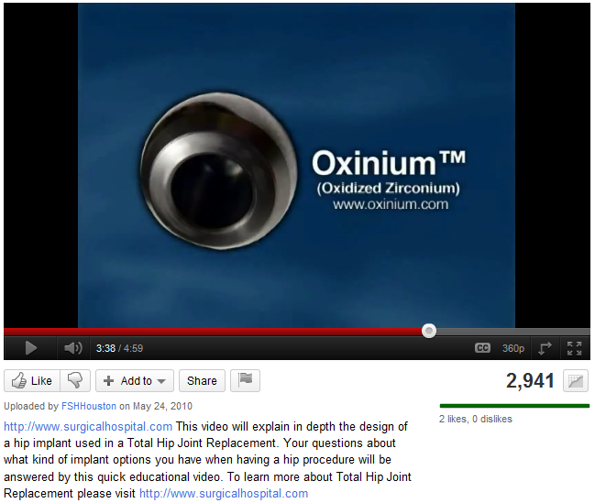
New material for implant
Louisiana Tech University
College of Engineering and Science
Hip implant types Animation Zirconium Advertisement
http://www.youtube.com/watch?NR=1&v=k-QOqOayBUQ

Slide 16
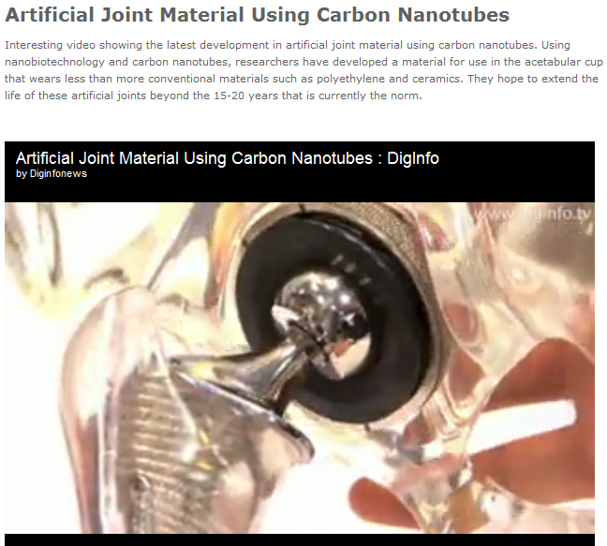
New product development
Louisiana Tech University
College of Engineering and Science
Hip implant new materials being developed, such as incorporating carbon nanotubes.
http://www.azom.com/materials-video-details.aspx?VidID=264

Slide 17
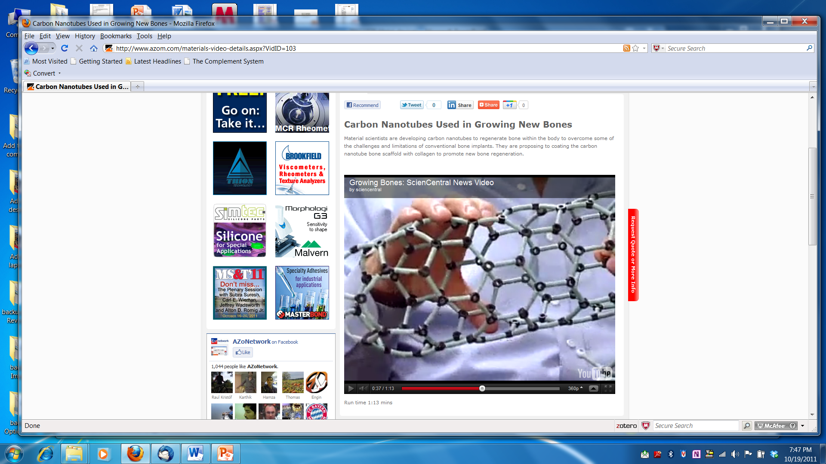
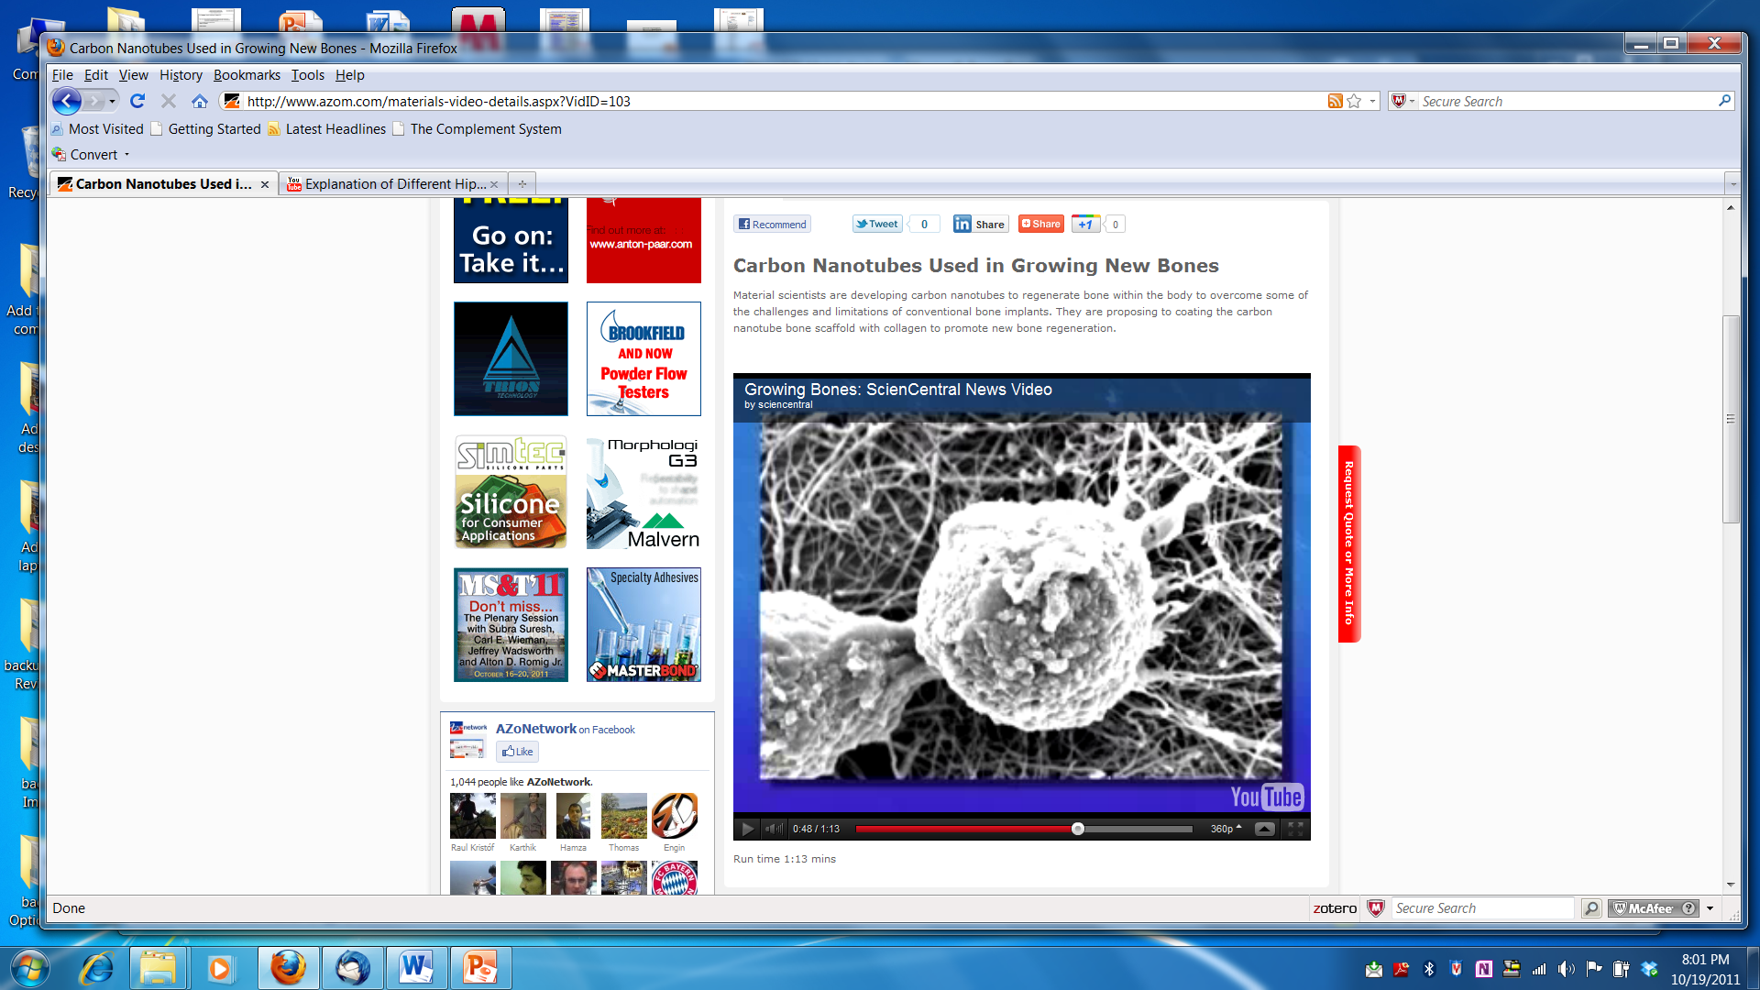
Growing bone: novel approaches
Louisiana Tech University
College of Engineering and Science
http://www.azom.com/materials-video-details.aspx?VidID=103

Slide 18

Louisiana Tech University
College of Engineering and Science
Growing bone: novel approaches
http://abclocal.go.com/kabc/video?id=8312311&syndicate=syndicate&section=

Slide 19
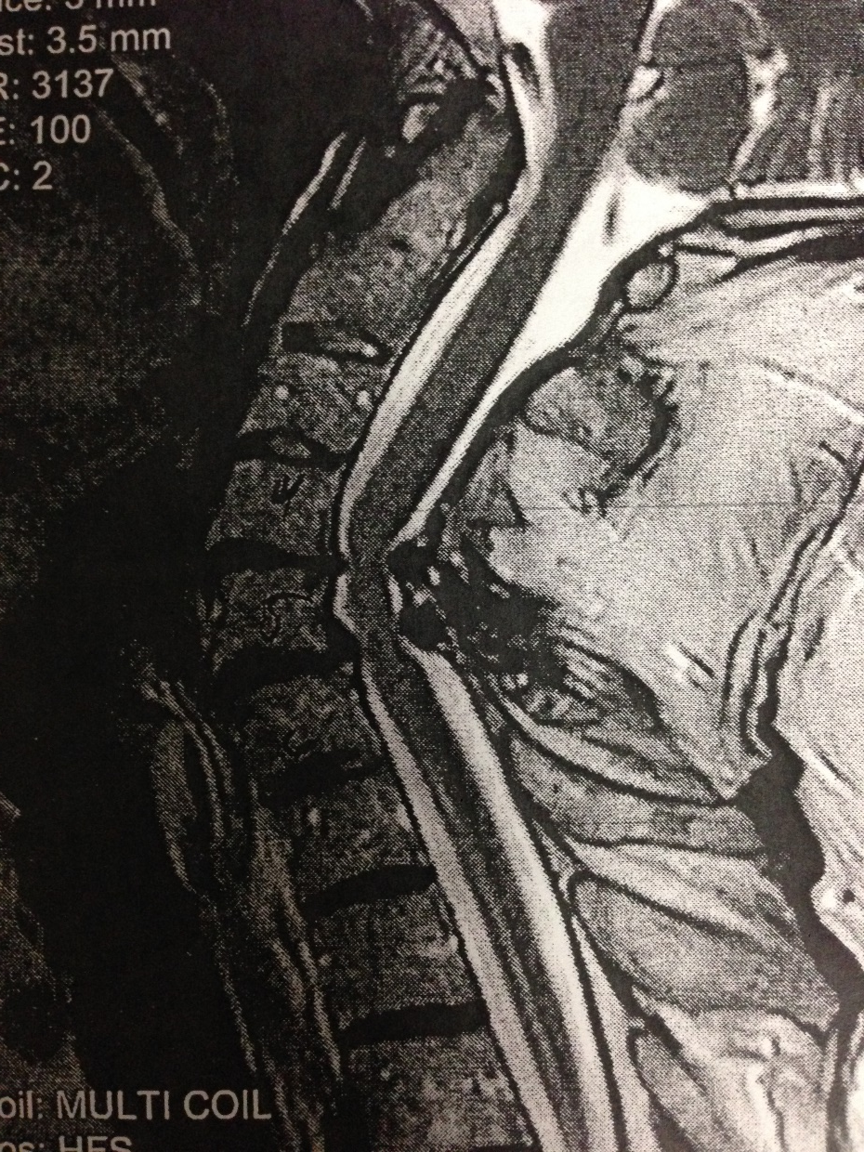
Spinal stenosis
Louisiana Tech University
College of Engineering and Science

Slide 20
Spinal fusion
Louisiana Tech University
College of Engineering and Science

Slide 21
Optional slides on ethical issues
You do not need to know this for an exam! However, this may be helpful for learning about technical and ethical issues regarding orthopedic implants.

Slide 22
Off-label testing of bone cement
Louisiana Tech University
College of Engineering and Science
A manufacturer of bone cement went straight to clinical trials (no IDE), despite an indication that their bone cement caused blood clotting. Three deaths occurred and they're paying $20+ million in damages.
http://www.fda.gov/MedicalDevices/Safety/RecallsCorrectionsRemovals/ListofRecalls/ucm238423.htm
http://www.outpatientsurgery.net/news/2010/12/7-synthes-admits-guilt-in-illegal-off-label-bone-cement-testing

Slide 23
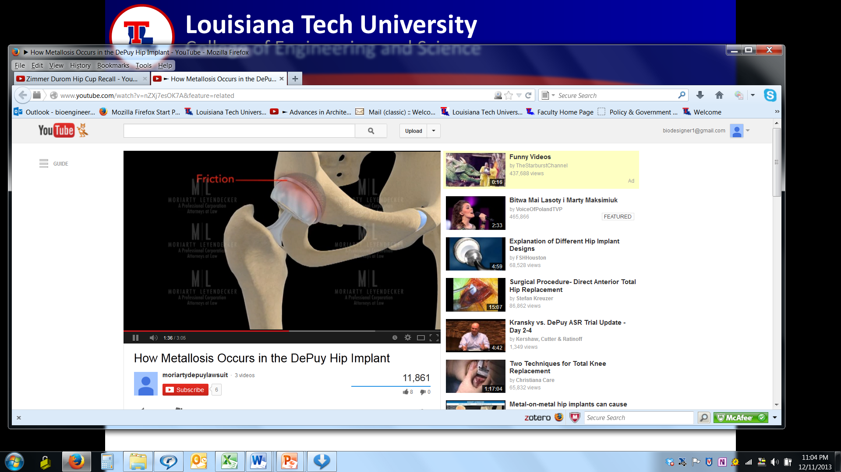
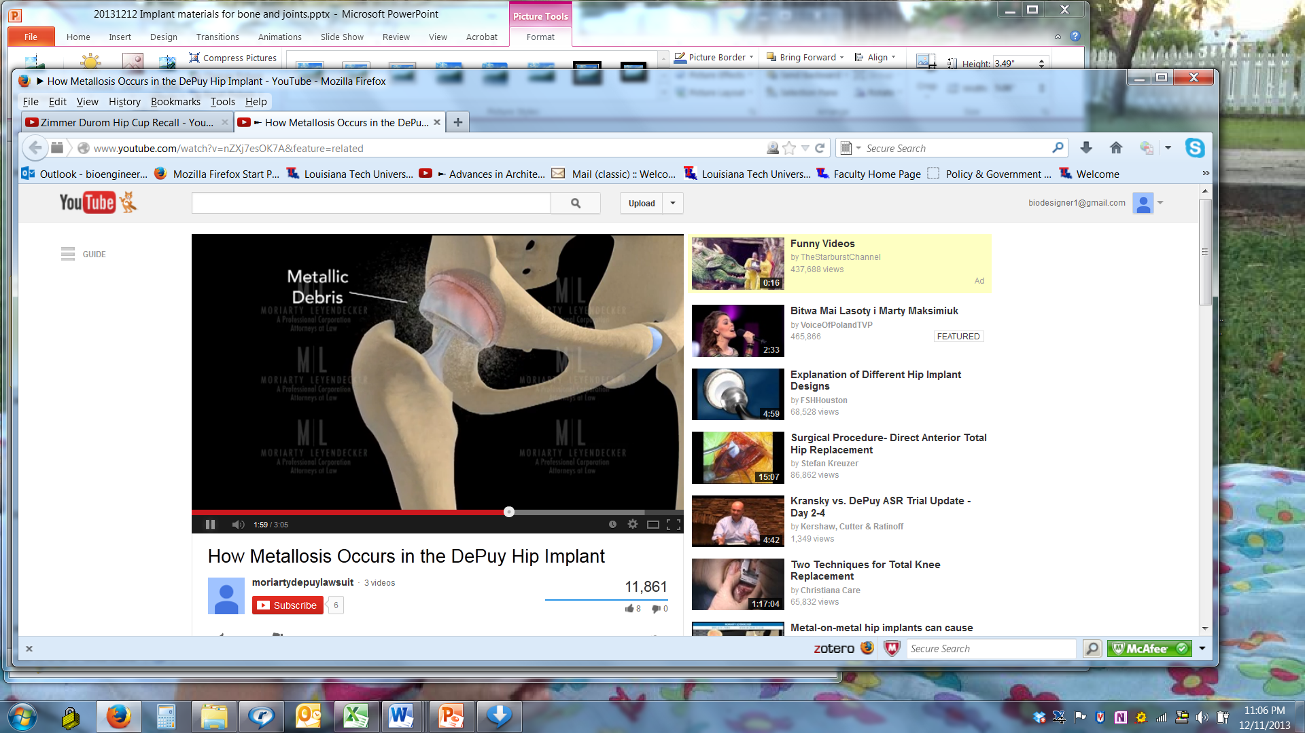
DePuy MOM total hip recall
Louisiana Tech University
College of Engineering and Science
Hip animation and implant animation with metal debris (metalosis)
http://www.youtube.com/watch?v=nZXj7esOK7A&feature=related

Slide 24
Louisiana Tech University
College of Engineering and Science
“Information for Physicians Who Believe They May Have a Patient With a Sensitivity to Metal
The most common metallic sensitizers that are used in orthopaedic alloys are nickel, cobalt, and chromium.
Orthopaedic grades of stainless steel and cobalt-chromium alloys both contain these materials while titanium and titanium alloys do not. … The excellent biocompatibility of titanium and its alloys, such as Ti-6Al-4V alloy, is well documented. Persons with a history of allergies, including sensitivities to cobalt, chromium, or nickel, generally do not exhibit or develop sensitivity to titanium or other constituents of Ti-6Al-4V alloy.”
http://www.zimmer.com/web/enUS/pdf/Metal_Sensitivity_Information_Sheet_02-21-2011.pdf

Slide 25
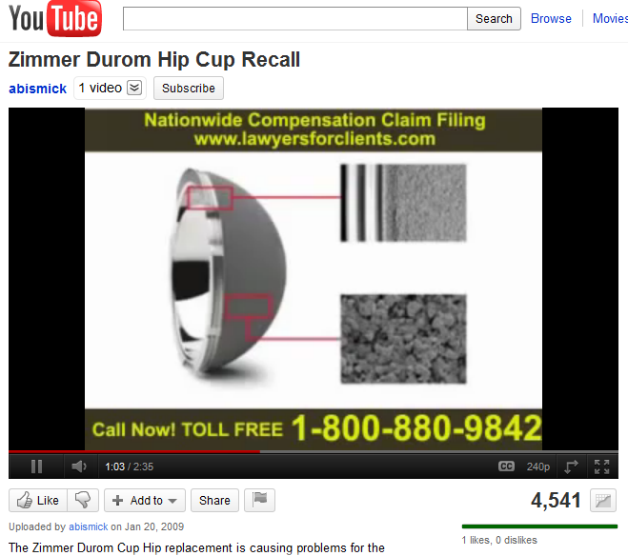
Zimmer Durom acetabular cup recall
Louisiana Tech University
College of Engineering and Science
In US, coating on Zimmer “Durom ” cup is thicker than those sold outside the US. No revision surgeries reported outside the US (almost 400 cases) per law firm advertisement.
http://www.youtube.com/watch?NR=1&v=-Y74iV5dUZQ

Slide 26
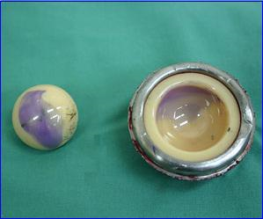
Stryker hip implant
Louisiana Tech University
College of Engineering and Science
“My dad’s hip is squeaking!” http://www.youtube.com/watch?NR=1&v=dkLDm9tgW1U
Man walking up stairs “T This is the sound a $40,000.00 Stryker Ceramic on Ceramic hip makes.”
http://www.youtube.com/watch?v=rviIIuGC1Xw
Figure http://www.millerandzois.com/stryker-hip-settlement.html

Slide 27
Timeline of Stryker recall
Louisiana Tech University
College of Engineering and Science
February 3, 2003: FDA approves hip replacement system.
January 2005 to April 2007: Stryker receives large number of patient complaints, but takes no significant action.
March 15, 2007: FDA sends warning letter about manufacturing facility in Ireland. “… inspection revealed that these devices are adulterated within the meaning of section 501(h) of the Act (21 U.S.C. § 351(h)), in that the methods used in, or the facilities or controls used for, their manufacture, packing, storage, or installation are not in conformity with the Current Good Manufacturing Practice (CGMP) requirements of the Quality System (QS) regulation.”
Source: http://www.millerandzois.com/stryker-hip-settlement.html

Slide 28
Timeline of Stryker recall
Louisiana Tech University
College of Engineering and Science
November 28, 2007: FDA sends second letter warning Stryker. “Customer complaints have been received for squeaking/noisy ceramic on ceramic hip joints.”
January 22, 2008: Stryker initiates a voluntary recall. “As a result of the deviation from internal specifications, the Company is initiating a voluntary recall of Trident PSL and Hemispherical Acetabular Cups manufactured in its Cork facility.”
Source: http://www.millerandzois.com/stryker-hip-settlement.html
Source: http://www.millerandzois.com/stryker-hip-settlement.html

Slide 29
Hip Implant recalls
Louisiana Tech University
College of Engineering and Science
Depuy ASR XL Acetabular and ASR Hip Resurfacing Systems (metal-on-metal head and cup)
Smaller cup than other mfgrs. → edge-loading, metal debris, loosened implants (osteolysis?)
Zimmer Durom Cup (cup has porous surface for bone ingrowth)
No bone ingrowth; loosened; severe pain
Stryker Trident PSL and Trident Hemispherical Acetubular Cup (ceramic cups)
Squeaks and pops

Slide 30
Payments to Doctors
Louisiana Tech University
College of Engineering and Science
A study looked at payments to doctors from 5 orthopedic device companies (Archives of Internal Medicine, Sept 2010). In 2007, 41 doctors were paid $114 million, over 1 million each. Of these, 32 published papers the next year and half did not mention the large payments.
The companies were: *DePuy, *Stryker, *Zimmer, Biomet, and Smith & Nephew (*these also had product recalls, some noted previously)
Is doctor reports on a company’s products in a scholarly, scientific journal that fails to mention being paid $1 million dollars in a single year by that same company ethical?
2010 http://www.hip-replacement-and-recovery.com/payments-to-doctors.html

Slide 31
Optional: Types of hip implants
You do not need to know this for an exam!

Slide 32
Main types of hip implants
Louisiana Tech University
College of Engineering and Science
Total hip arthroplasty
Cemented cup and stem
Cementless (press fit) cup and stem
Hybrid (cemented stem, press fit cup )
Partial replacement
Femoral head only
Acetabular cup only
Hip resurfacing
Cover (resurface) femoral head
Replacement cup

Slide 33
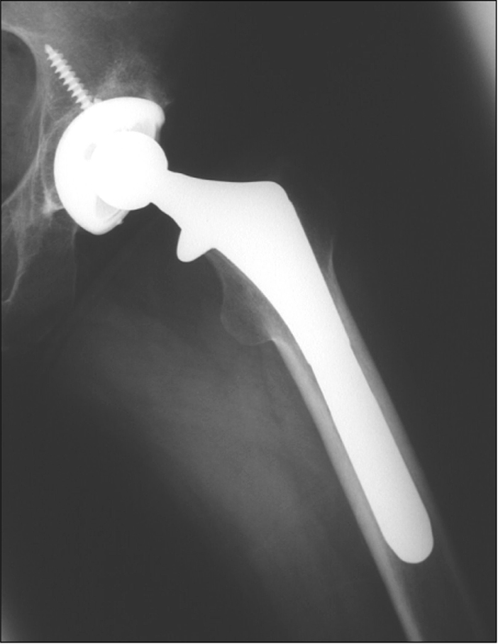
Louisiana Tech University
College of Engineering and Science
Total hip arthroplasty
Femoral component (metal, press fit, cementless) and acetabular component (polyethylene cup with metal backing, screw fixation)
http://emedicine.medscape.com/article/398669-overview

Slide 34
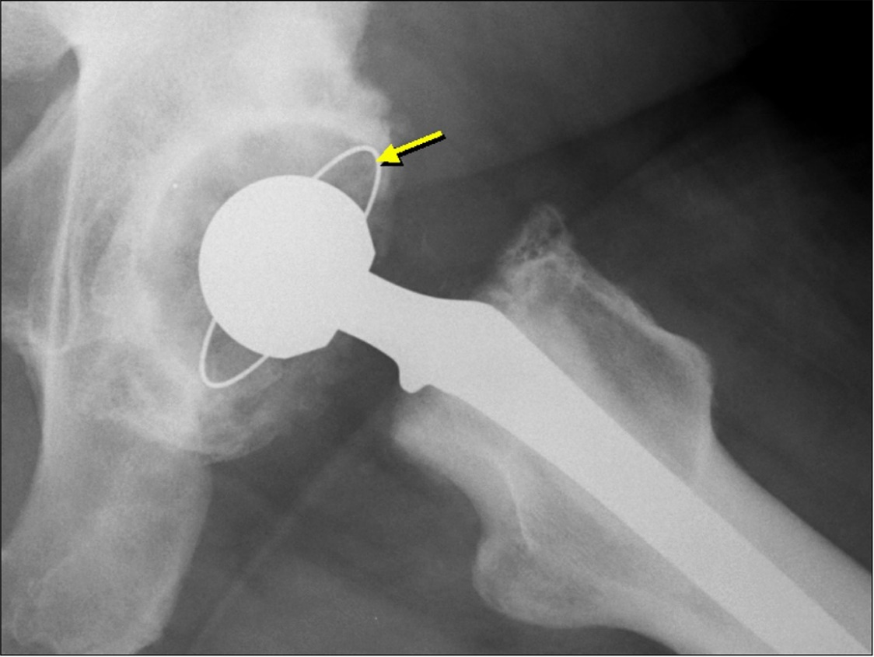
Louisiana Tech University
College of Engineering and Science
Total hip arthroplasty
Femoral component (cemented metal)
Acetabular cup (polyethylene, cemented [yellow arrow points to radio-opaque rim of cup])
http://emedicine.medscape.com/article/398669-overview

Slide 35
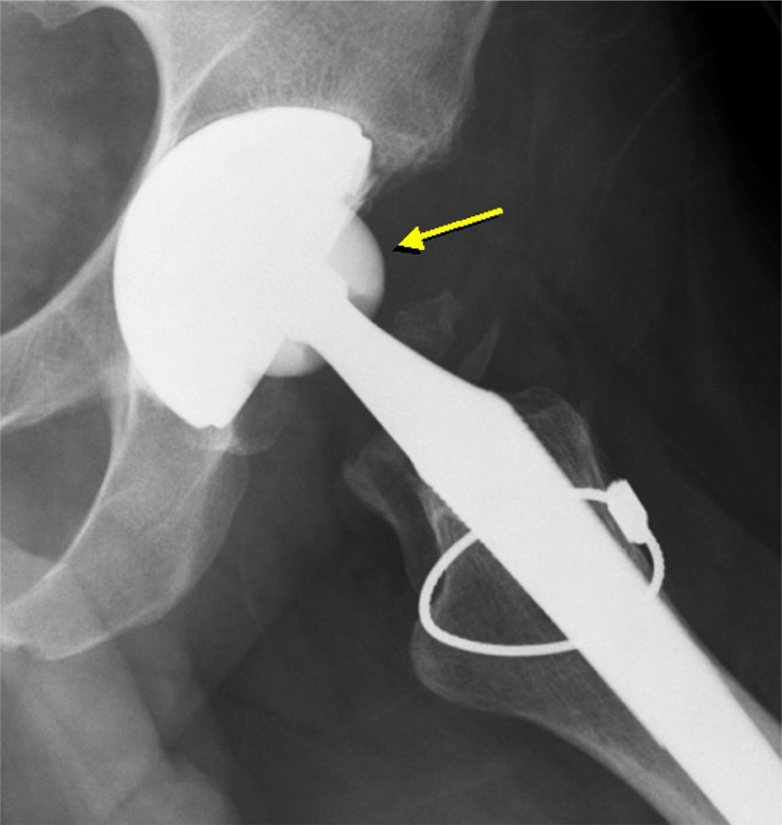
Louisiana Tech University
College of Engineering and Science
Total hip arthroplasty
Radiograph shows femoral component (ceramic head [arrow], metal stem [no cement], cable) and acetabular component (ceramic cup, metal backing, cementless)
Note: ceramic head is less dense than metal
http://emedicine.medscape.com/article/398669-overview

Slide 36
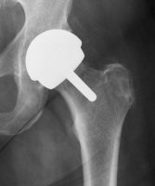
Louisiana Tech University
College of Engineering and Science
Resurfacing total hip arthroplasty.
Femoral component (metal head and stem) Acetabulum component (metal, cementless).
Note: large femoral head and preserved femoral neck.
http://emedicine.medscape.com/article/398669-overview

Slide 37
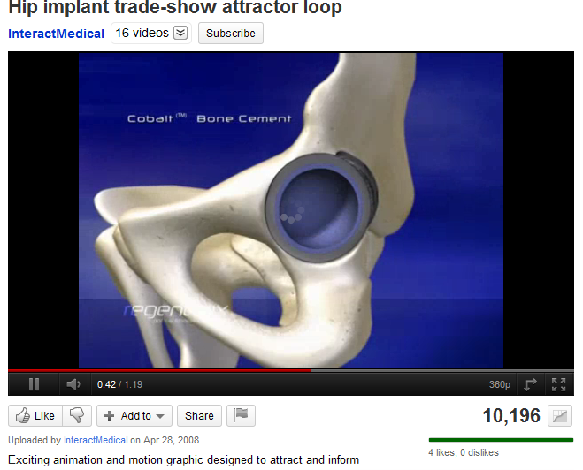
Louisiana Tech University
College of Engineering and Science
Regenerex porous titanium fixation for acetabular cup
http://www.youtube.com/watch?v=d18mN_3SAZI&feature=related

